Slide 1
Predictive Pest Management for Sustainable Agriculture Project Course : Graduate Project – EE 697
presented by
Kalyanapu Raja
Master’s Electrical And Computer Engineering
Presentation Date : 4-12- 23

Slide 2

Course instructor:
Dr. Leon Jololian
Ph.D., Computer Science, NJIT
Professor at UAB School of Engineering
Interim Chair, Professor, Undergraduate & Graduate Program Director
Leon Jololian is the director of the UAB Center For Integrated Systems.

Slide 3
Table of contents
Goals of the project.
Key features of the project.
Technology stack.
Design And Implementation:
Model Configuration:
Results And Discussions :
Challenges.
Future scope.
Conclusion.
References

Slide 4
Goals of the Project:
User-friendly digital solution for agricultural pest management.
Implement advanced technology for accurate pest identification, improving farmer's response to infestations.
Aid in maintaining healthier crops by providing timely pest control solutions.
Contribute to environmentally conscious agriculture through efficient pest management.

Slide 5
Key features of the project:
1. Utilize experienced AI technology to enhance the accuracy of pest detection.
2. Uses a large dataset of 10,988 images for diverse pest identification.
3. Offers quick and reliable identification of pests from uploaded images.
4. Provides solutions based on collected data, adjust to specific pest challenges.
5. Provides user-friendly access for farmers of all tech skill levels.

Slide 6
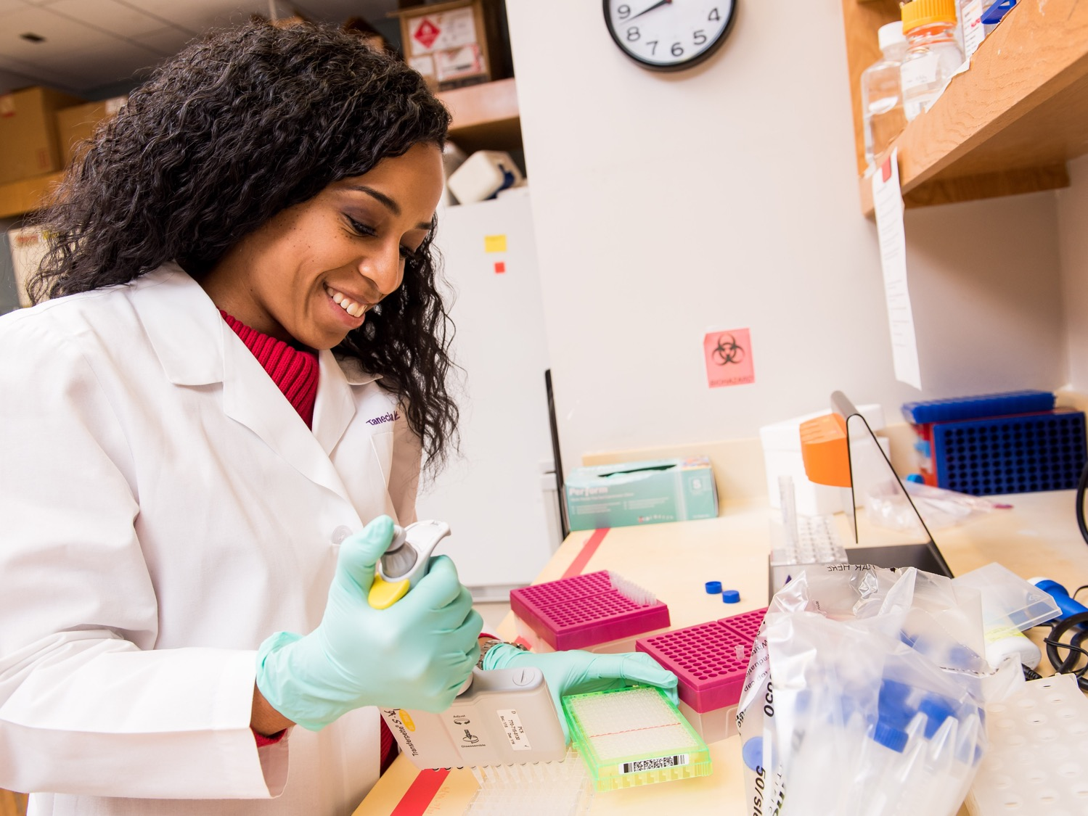
Technology Stack:
1. Deep Learning : Used a framework like TensorFlow, Keras, or PyTorch .
2. Image Processing: Used a libraries like PIL and OpenCV.
3. Gradio: Used to create interactive web interfaces for machine learning models.
4. IDE Tools : Used Jupyter Noterbook for coding and testing .

Slide 7
Design And Implementation:
Image datasets are imported in batches for model training to reduce memory overload that can occur from processing the entire dataset simultaneously.
Training and validating datasets in the ratio of 80% for training and 10% for validation. The remaining 10% is spared for testing the accuracy of the built model.
Training the models: The following flowchart represents different steps involved in the training process.

Slide 8
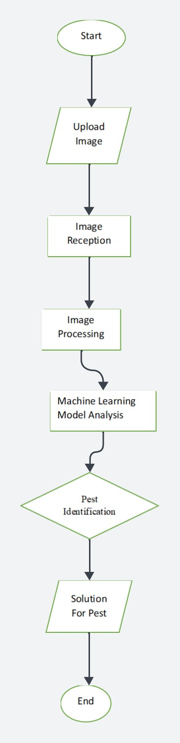
Fig 1: Flow diagram of training

Slide 9
Model Configuration:
Activation Function: ReLU (for dense layers)
Optimizer: Adam
Training Epochs: 12
Batch Size: 32
Image Dimensions: (224, 224, 3)
Metrics:
Categorical Accuracy
Top-K Categorical Accuracy (k=2, name='top_k_accuracy')

Slide 10
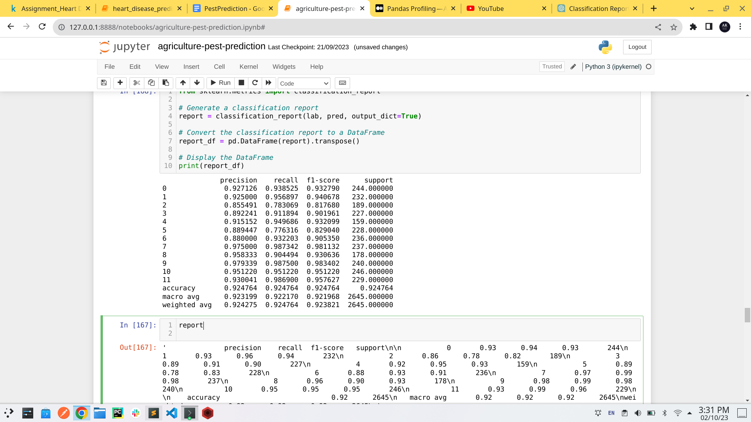
Results And Discussions :
Model Performance : The Accuracy of the deep learning model demonstrated impressive accuracy rates in identifying various pests within the dataset .
On test dataset these are the accuracies .Our model which is using pretrained resnet 50 is giving 92.4% accuracy .

Slide 11
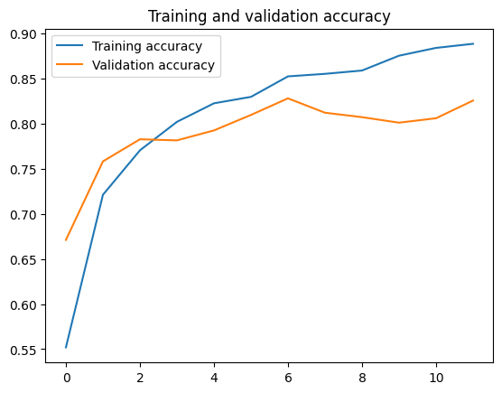
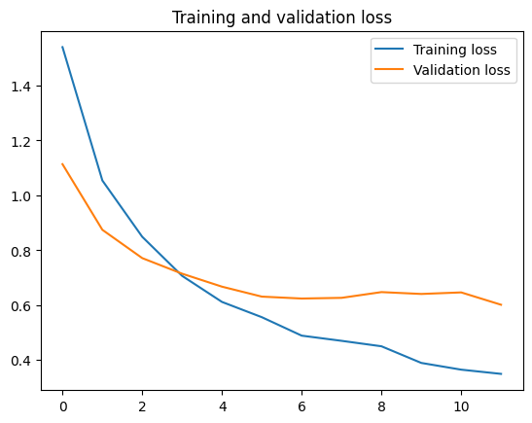
During training, the model was fine-tuned using the validation set. This iterative process ensured that the model's parameters were optimized for pest identification.

Slide 12
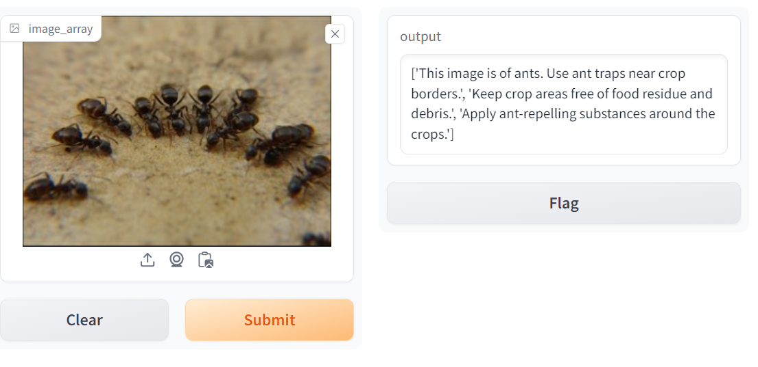
Output of model :

Slide 13
Challenges:
Getting enough diverse pest images for training can be hard.
Some pests may not have many images, making it tough for the model.
Making the model too complicated can lead to errors.
Pest images from farms can look very different due to light and other factors.
Making the model easy for farmers to use might need more work.

Slide 14
Future scope:
Improving Accuracy: Keep making the model better at identifying pests.
Mobile Apps: Create easy phone apps for farmers to use.
Real-Time Alerts: Give farmers alerts about pests right away.
User Feedback: Listen to farmers and make the platform better for them.
Eco-Friendly Farming: Help farmers use fewer chemicals and farm more sustainably.
Global Farming: Make the platform useful all over the world.

Slide 15
Conclusion:
In conclusion, our pest identification platform is a game-changer for farmers. It helps them spot and deal with pests, making farming easier and more eco-friendly. We'll keep making it better, and together with farmers and experts, we're shaping the future of farming.

Slide 16
References :
1) C. S. Rao, M. Rahul, S. Dasgupta and R. Hegde, "Sustainable Pesticide usage in Agriculture," 2021 IEEE Mysore Sub Section International Conference (MysuruCon), pp. 628-633, 2021
2) Tanha Talaviya, Dhara Shah, Nivedita Patel, Hiteshri Yagnik, Manan Shah, “Implementation of artificial intelligence in agriculture for optimisation of irrigation and application of pesticides and herbicides”, Artificial Intelligence in Agriculture, vol 4, pp 58-73, 2020.
3) Hussain M., Bird J.J., Faria D.R. “A Study on CNN Transfer Learning for Image Classification”, Advances in Computational Intelligence Systems, Advances in Intelligent Systems and Computing, vol 840, pp 191-202, 2019.

Slide 17
THANK YOU!

